Slide 1
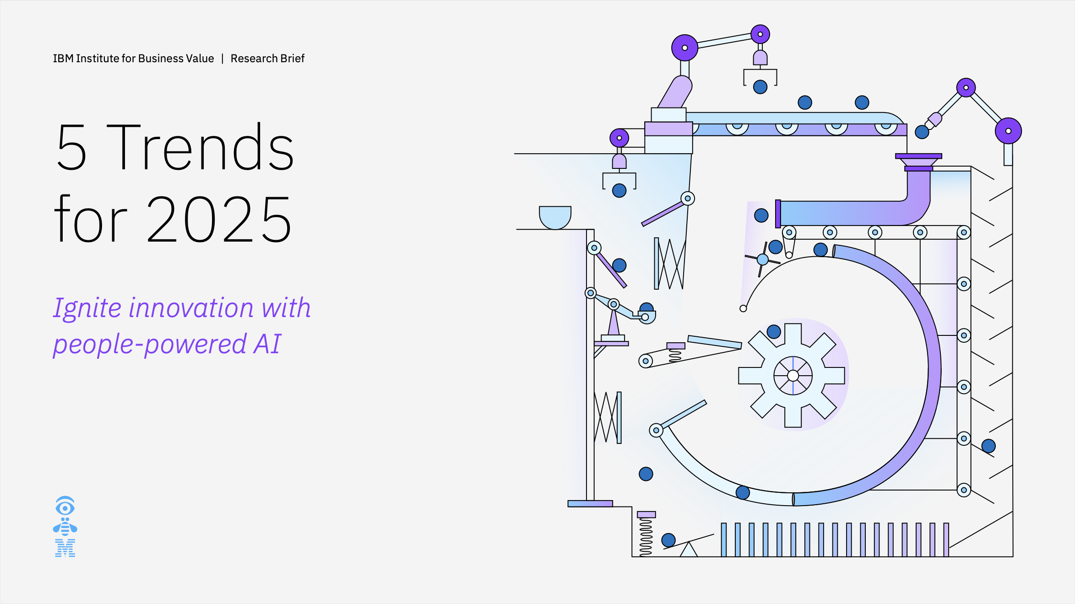
Five Trends for 2025 Ignite innovation with people-powered AI

Slide 2
To fully leverage AI, leaders must address the five emerging trends in 2025. Emphasizing agility and empowering teams will be essential for overcoming challenges and driving growth.
Five Trends for 2025
Trend 1: Agentic AI will transform your business—but first you must reskill your people.
Trend 2: Despite efforts to slow its growth, technical debt continues to increase.
Trend 3: In the age of AI, location is everything.
Trend 4: The rapid pivot to AI has upended IT budgets, but self-funding is imminent.
Trend 5: AI product and service innovation is the #1 CEO goal, yet business models aren’t keeping up.
Interested in seeing how our past top trends have played out? Find them here:
2024 | 2023 | 2022 | 2021 | 2020 | 2019

Slide 3

Agentic AI will transform your business—but first you must reskill your people.

Slide 4
Factors shaping trends
Trend 1: Agentic AI will transform your business—but first you must reskill your people.
Escalating reskilling demands due to AI's rapid evolution present workforce challenges
Employee readiness and adoption are critical factors for successful AI implementation.
Inadequate AI training and change management hinder agentic AI's transformative potential.
In 2024, global CEOs estimated that, on average, 35% of their workforce needed to be reskilled. ¹
And, executives say AI literacy is the most critical capability their workforce will need in 2026. ²
For CEOs, 64% say succeeding with AI depends more on people's adoption than the technology itself… ¹
Yet 47% of executives say their people lack the knowledge and skills to implement and scale AI across the enterprise. ⁴
Among executives, only 22% strongly agree that their organization has integrated AI knowledge, skills, and abilities into employee professional development plans. ⁴
And, less than half have implemented a formal change management program to enable the integration of AI assistants and agents into daily workflows. ⁴
Notes:
Sources:
The 2024 CEO Study. 6 hard truths CEOs must face: How to leap forward with courage and conviction in the generative AI era. IBM Institute for Business Value. May 2024. https://ibm.co/c-suite-study-ceo
Goldstein, Jill, Chris Havrilla, Chacko Thomas, and Catherine Fillare. Reimagine human potential in the gen AI era: Revolutionizing work to boost business value. IBM Institute for Business Value. September 2024. https://ibm.co/humanpotential-genai
Five trends for 2025 Global Pulse Survey.

Slide 5
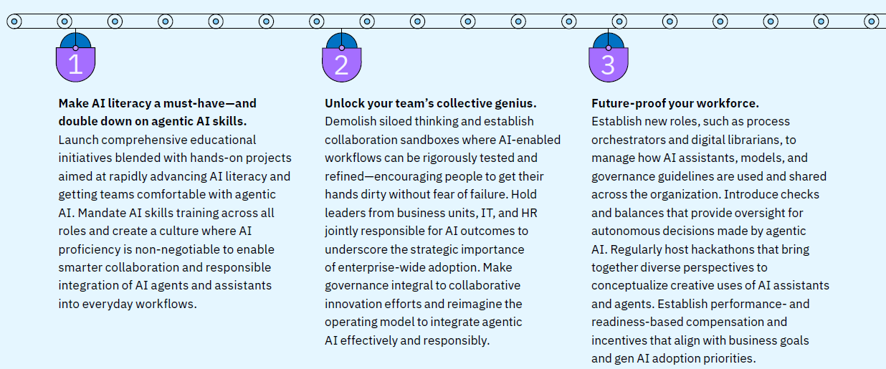
What to do
Trend 1: Agentic AI will transform your business—but first you must reskill your people.

Slide 6

Despite efforts to slow its growth, technical debt continues to increase.

Slide 7
Factors shaping trends
Trend 2: Despite efforts to slow its growth, technical debt continues to increase.
Mounting technical debt hinders long-term innovation and growth.
Scaling AI across the enterprise remains a critical challenge for organizations.
Balancing short-term gains with long-term investments in system modernization.
55% of executives say technical debt is either a major obstacle or a real roadblock to achieving business goals. ¹
Technical debt is a challenge for 74% of organizations, including 42% that say it is a significant obstacle. ²
While 77% of executives say they need to adopt gen AI quickly to keep up with competitors… ³
Only 25% of executives strongly agree that their organization’s IT infrastructure can support scaling AI across the enterprise. ⁴
On average, IT executives from companies adopting hybrid by design for their digital transformation efforts reported 3X higher ROI than those that don’t. ⁵
However, two-thirds of CEOs say they’re meeting short-term targets by reallocating resources from longer-term efforts. ⁶
Notes:
Sources:
From chaos to cash: How hybrid by design creates business value. IBM Institute for Business Value. May 7, 2024. https://ibm.co/from-chaos-to-cash
“Technical debt is deceptively costly to organizations, CompTIA research shows.” November 15, 2023. https://www.comptia.org/newsroom/technical-debt-is-deceptively-costly-to-organizations-comptia-research-shows
Goehring, Brian, Manish Goyal, Ritika Gunnar, Anthony Marshall, and Aya Soffer. The ingenuity of generative AI: Unlock productivity and innovation at scale. IBM Institute for Business Value. June 2024. https://ibm.co/scale-generative-ai
Five trends for 2025 Global Pulse Survey.
ROI remedy: How hybrid by design can improve business returns on your tech investments. IBM Institute for Business Value. June 2024. https://ibm.co/hybrid-by-design-ROI-remedy
The 2024 CEO Study. 6 hard truths CEOs must face: How to leap forward with courage and conviction in the generative AI era. IBM Institute for Business Value. May 2024. https://ibm.co/c-suite-study-ceo

Slide 8
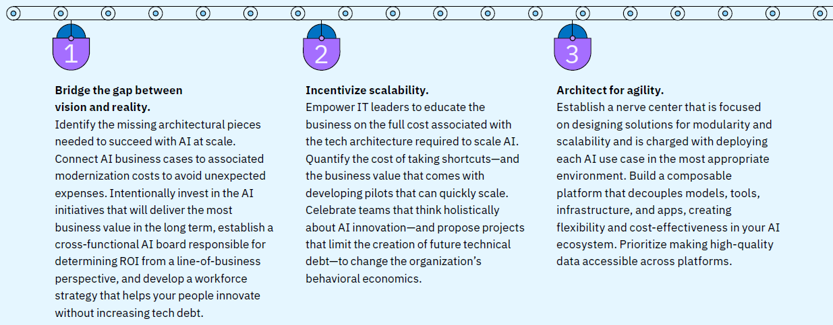
What to do
Trend 2: Despite efforts to slow its growth, technical debt continues to increase.

Slide 9

In the age of AI, location is everything.

Slide 10
Factors shaping trends
Trend 3: In the age of AI, location is everything.
Increasing disruptions complicate location strategy decision-making.
AI adoption introduces new factors in determining optimal operational locations.
Navigating the trade-off between targeted market focus and global expansion.
For executives in 2024, 86% said their location strategy was impacted by geopolitical disruption… ¹
And that figure is expected to rise to 93% in 2026. ¹
In 2024, 67% of executives say their organization’s use of AI changed where they operated—and 93% expect AI to impact their location strategy in 2026. ¹
And, 96% of executives say data privacy, security, and regulations will determine where they locate operations in the next two years. ¹
89% of executives agree that they are both widening their reach by extending operations globally and primarily focusing on a few core markets. ¹
37% of executives say they will manage their data strategy and governance more regionally in 2025, with 26% saying they will take a more global approach. ¹
Notes:
Sources:
Five trends for 2025 Global Pulse Survey.

Slide 11
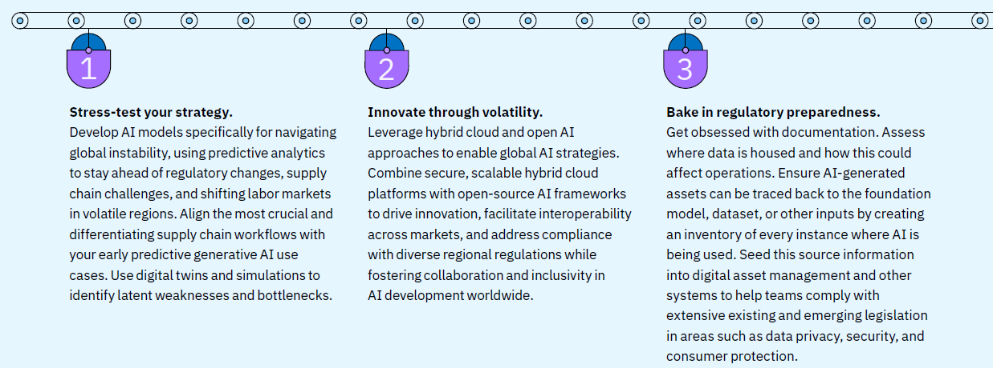
What to do
Trend 3: In the age of AI, location is everything.

Slide 12

The rapid pivot to AI has upended IT budgets, but self-funding is imminent.

Slide 13
Factors shaping trends
Trend 4: The rapid pivot to AI has upended IT budgets, but self-funding is imminent.
Disruptions in IT budgeting from generative AI adoption hinder clear funding decisions.
Realizing the full potential takes time, but self-funding for generative AI is projected by 2026.
Balancing cost-cutting with growth-driven AI investments complicates ROI optimization.
In 2024, one in three organizations pulled funding for gen AI from other IT initiatives, with only 18% of tech execs funding these projects with net-new spend. ¹
And, executives report that infrastructure, cloud, and data account for more than 40% of gen AI costs. ²
Among executives, 95% say gen AI will be at least partially self-funded by 2026, with a focus on driving future profitability. ³
And, 71% of executives said gen AI should be self-funded to justify its investments. ⁴
In 2024, 71% of gen AI spending went to cost-cutting functions, while only 29% went to product-related business functions. ³
And, the average gen AI investment takes almost 14 months to deliver positive ROI, compared to just 10 months for other technology investments. ⁴
Notes:
Sources:
The CEO’s guide to generative AI, second edition. IBM Institute for Business Value. January 2025.
The CEO’s guide to generative AI: Cost of compute. IBM Institute for Business Value. October 7, 2024. https://ibm.co/ceo-generative-ai-cost-of-compute
Five trends for 2025 Global Pulse Survey.
Unpublished data, IBM Institute for Business Value Generative AI and Innovation Spend Pulse (AI Academy) Survey of 200 US executives. Final data. August 2024.

Slide 14
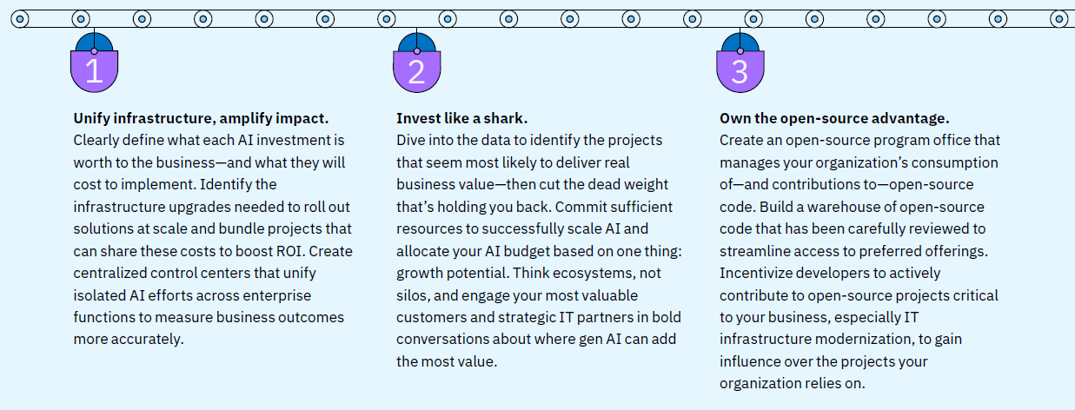
What to do
Trend 4: The rapid pivot to AI has upended IT budgets, but self-funding is imminent.

Slide 15

AI product and service innovation is the #1 CEO goal, yet business models aren’t keeping up.

Slide 16
Factors shaping trends
Trend 5: AI product and service innovation is the #1 CEO goal, yet business models aren’t keeping up.
Innovating business models amid shifting priorities and market demands complicates CEO decision-making.
Leveraging AI's potential for innovation amid complexities in business and product development.
The demand for personalization and ecosystem partnerships complicates competitiveness.
For CEOs in 2024, business model innovation was cited as the top challenge they expect to face over the next three years, up from 10th place in 2023. ¹
But, among CEOs in 2024, product and service innovation was cited as their top priority over the next three years. ¹
Over the next three years, 85% of executives say AI will enable business model innovation and 89% say it will drive product and service innovation. ²
And, nine in ten executives already using gen AI for product idea generation say it differentiates their company by helping it respond to market shift faster. ³
Across 13 industries, executives agree that customer loyalty is the top differentiating factor to move the needle on ROI. ⁴
And, executives expect personalization and customization to be the top customer demands that will disrupt how their organization delivers products and services. ⁴
Notes:
Sources:
The 2024 CEO Study. 6 hard truths CEOs must face: How to leap forward with courage and conviction in the generative AI era. IBM Institute for Business Value. May 2024. https://ibm.co/c-suite-study-ceo
Unpublished data, IBM Institute for Business Value Consumer Research Study of 1,500 AI leaders in Retail and Consumer Products. Final data. August and September 2024.
The CEO’s guide to generative AI: Digital product engineering. IBM Institute for Business Value. April 29, 2024. https://ibm.co/ceo-ai-product-engineering
Harper, Scott, Joni Saylor, Dixie Adams, Matt Gierhart, and Nisha Kohli. Digital Product Alchemy: 5 lessons in driving revenue through customer obsession. IBM Institute for Business Value. May 10, 2024. https://ibm.co/digital-product-alchemy

Slide 17
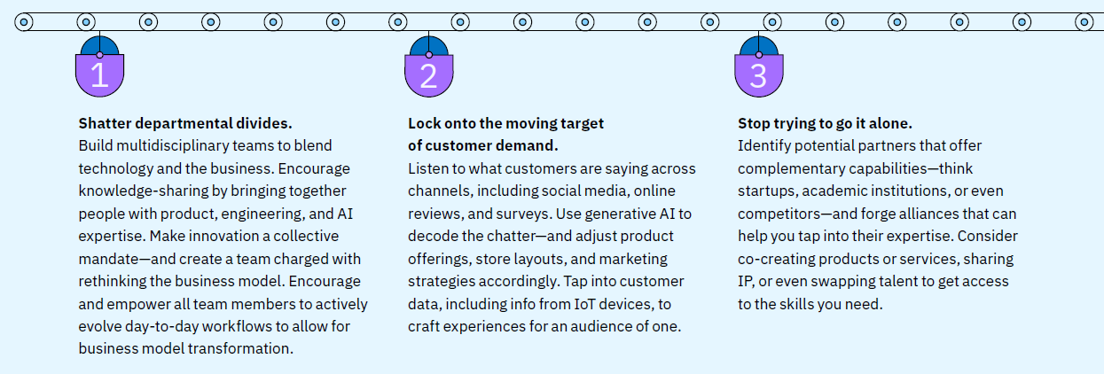
What to do
Trend 5: AI product and service innovation is the #1 CEO goal, yet business models aren’t keeping up.

